Slide 1
Texture/Bump Mapping
Radhika Mattoo
Computer Graphics Fall 2017

Slide 2
Overview
Texture/bump mapping on meshes
Cat “phone holder” with texture
Pear with texture & bump mapping

Slide 3
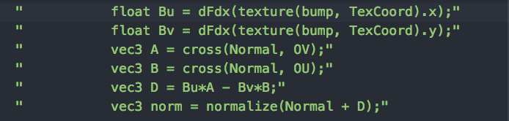
Problems
Triangulating meshes (Blender)
Finding a good height map for mesh
Calculating partial derivatives
Face and Vertex partials (CPU)
Bump map partials (GPU)
Moire pattern

Slide 4
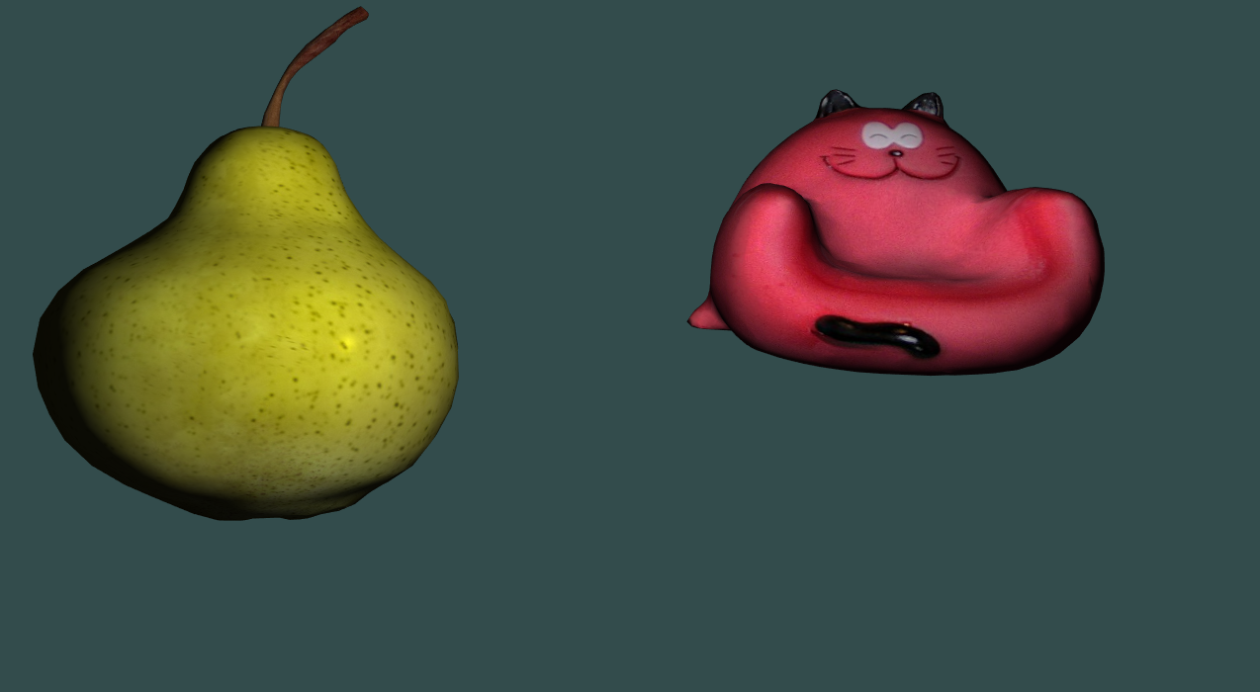
Texture Only

Slide 5
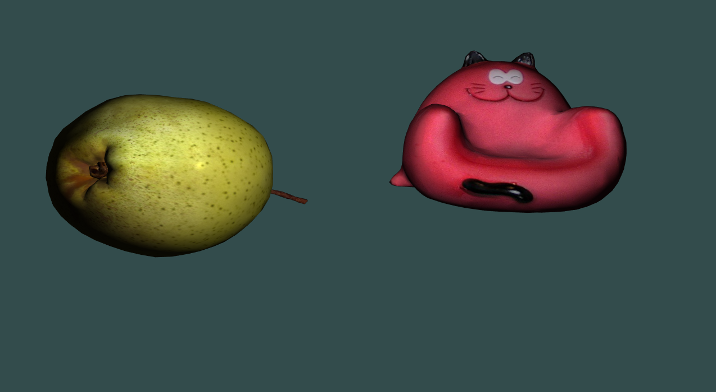
Texture Only

Slide 6
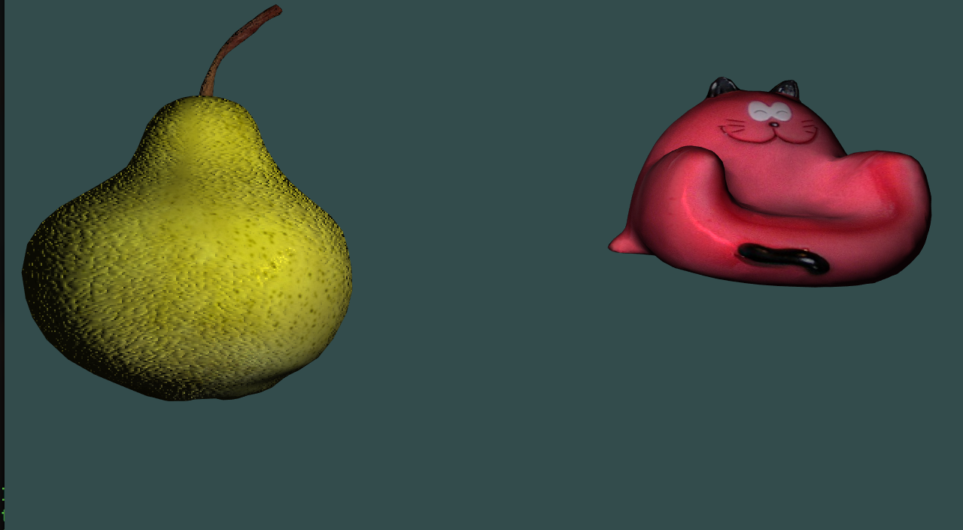
Bump Mapping & Texture

Slide 7
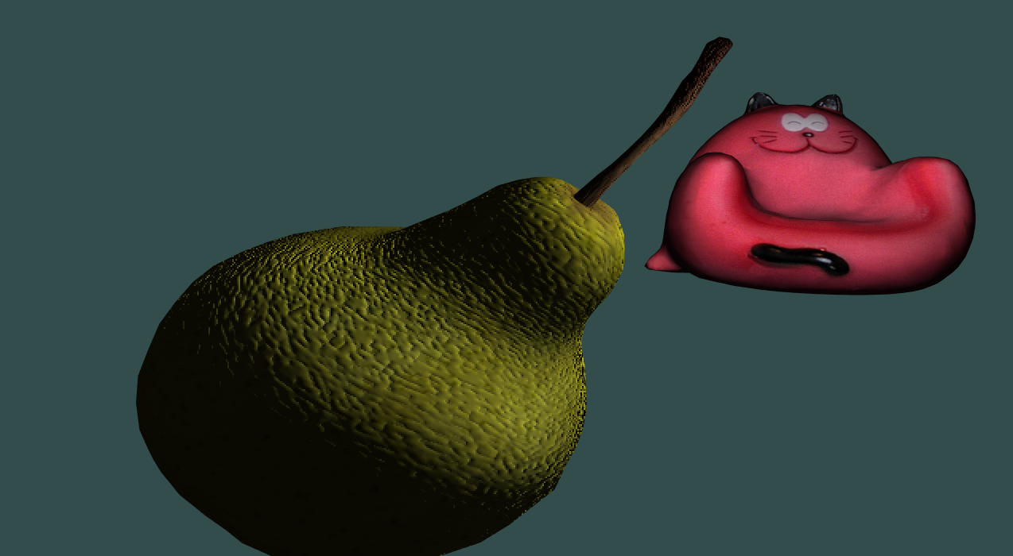
Bump Mapping & Texture

Slide 8
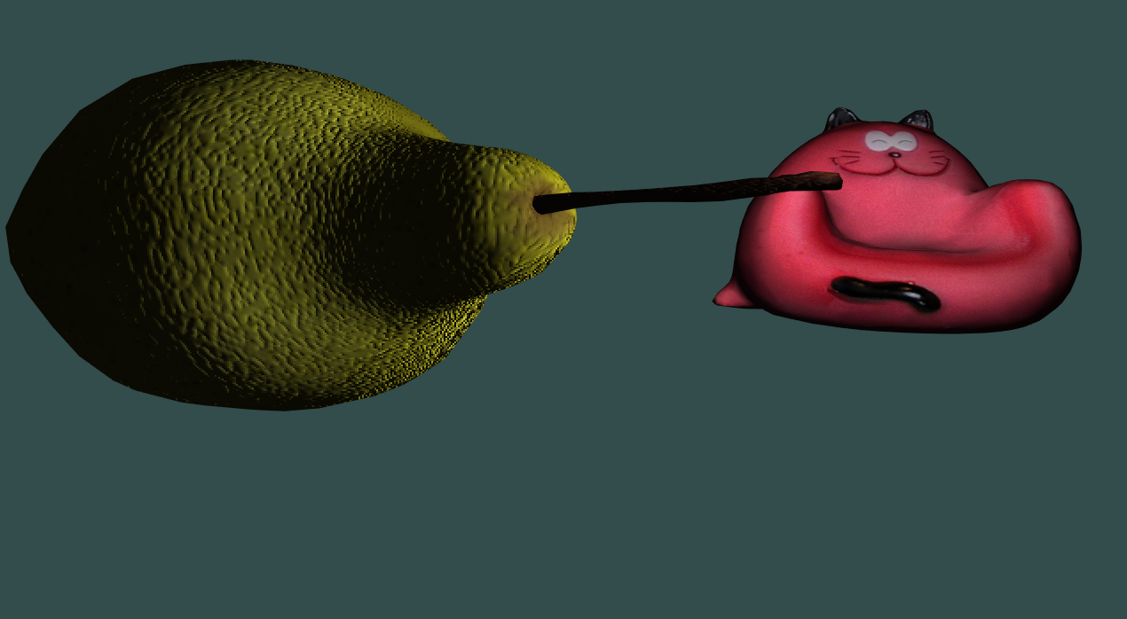
Bump Mapping & Texture

Slide 9
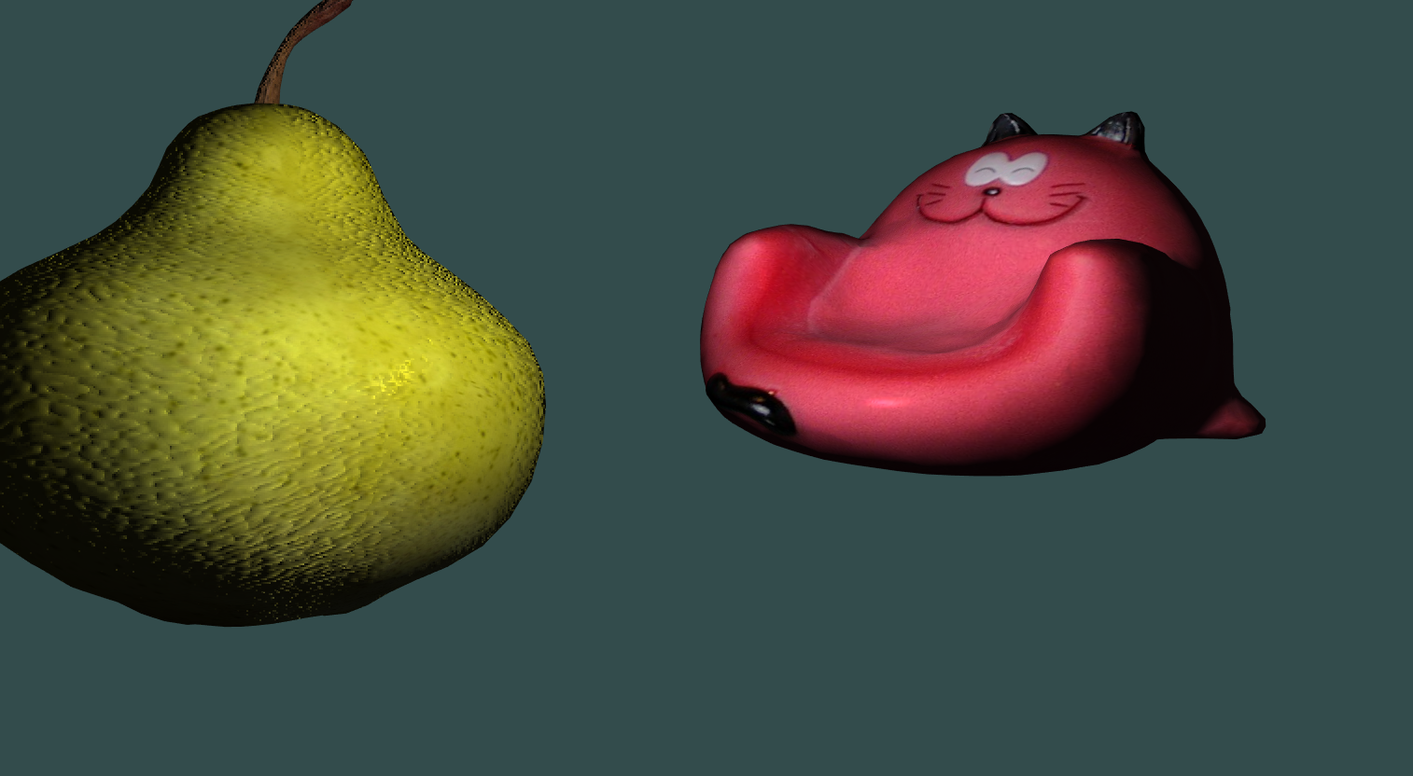
Bump Mapping & Texture

Slide 10
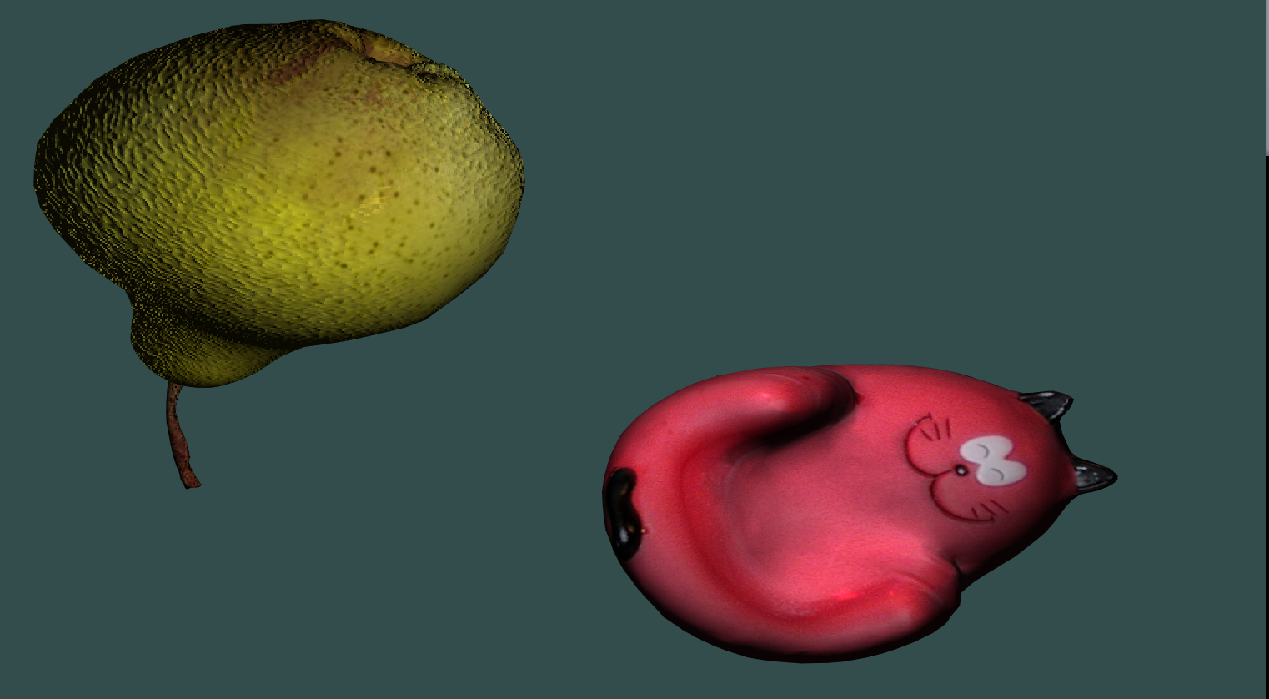
Bump Mapping & Texture

Slide 11
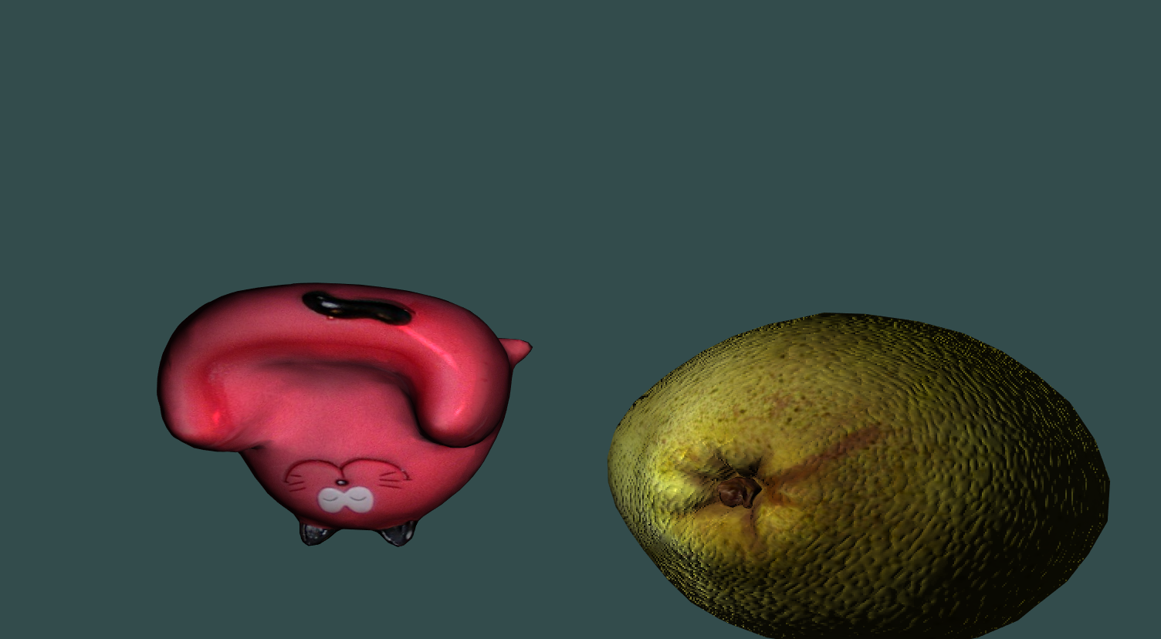
Bump Mapping & Texture

